Slide 1
Ionic crosslinking of cellulose nanocrystals
Han Chan, John Simonsen, John Nairn
Oregon State University

Slide 2
Outline
Much ado about percolation
What is it?
Literature reports
Nairn Model
Ionic crosslinking
Testing the hypothesis

Slide 3
PERCOLATION

Slide 9
PERCOLATION!

Slide 10
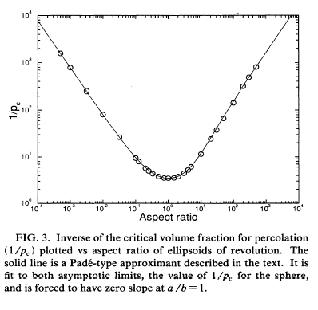
Monte Carlo simulation
Percolation threshold ~ 1%
Aspect ratio = 70
Garboczi, et. al. Phys. Rev. Ltrs. E, 1995, 52(1): 819-828

Slide 11
Electrical conductivity
Alvarez, et al., J. App. Poly. Sci., (2006) 99:3005-3008

Slide 12
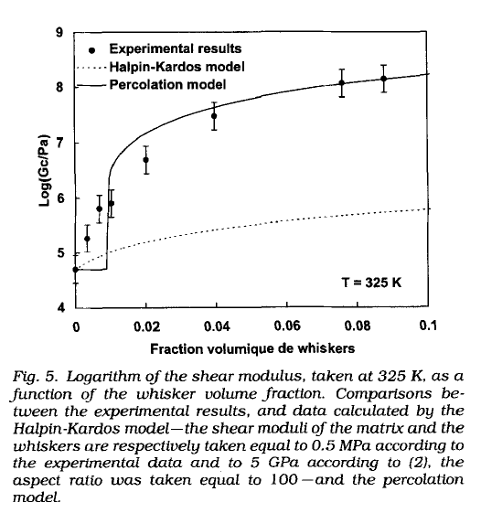
Favier, et al., Poly. Eng. Sci. 1995, 37(10), 1735

Slide 13
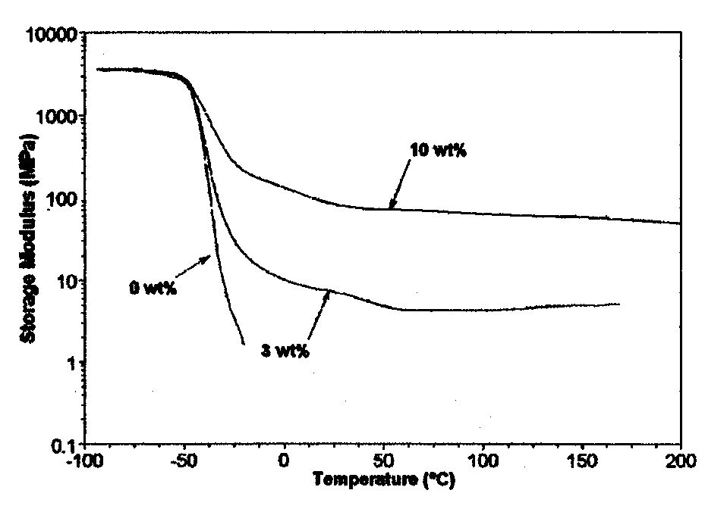
Battery Separator, CNCs in poly(ethylene oxide)
Fuel cell operating temp
M. Samir, F. Alloin, J-Y Sanchez, A. Dufresne, 2004. Macromol. 37:4839-4844

Slide 14
Enormous modulus loss on soaking in aqueous solution
Effective loss of percolation
Capadona, et al. Science 319 (2008) 1370

Slide 15
Shape-Memory effect
Mendez, et al. Macromol. 2011, 44, 6827

Slide 16
Shape-Memory effect
Self-propelled fishing lure
Mendez, et al. Macromol. 2011, 44, 6827

Slide 17
A general problem for composites
Faria, et al. J. Reinf. Plas. Comp. 2011, 30(20), 1729

Slide 18
A general problem for composites
Muthirakkal, et al. Iran. Poly. J. 2010, 19(2), 89

Slide 19
Carbon fiber has the same issue
Pultruded vinyl ester-carbon fiber reinforced composite
Interlaminar shear stress
Yu, et al. Polymer Composites, 2009, 1458

Slide 20
Glass fiber in nylon
As fiber content increases degradation of properties increases upon exposure to water
Hassan, et al. J. Reinf. Plas. Comp. 2011, 30(6), 488

Slide 21
Susceptibility to moisture
Most fiber-filled composites are susceptible to moisture intrusion
The interphase appears to be adversely affected by moisture intrusion
This is not a percolation effect, it is an interphase effect

Slide 22
The Nairn model vs.
The percolation model

Slide 23
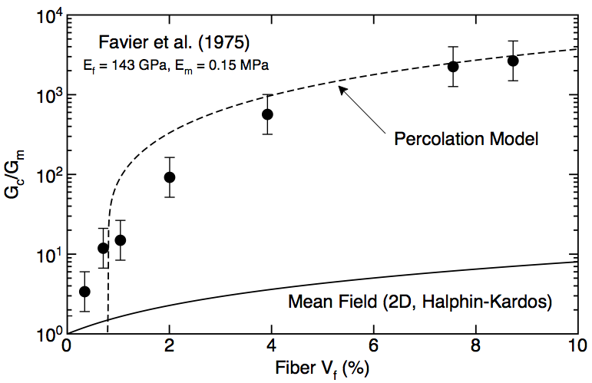
Use Model to Interpret Experiments
Experiments explained by
“percolation” which is a
nano phenomenon
Great reinforcement
of the matrix
(>1000X)
Favier et al. (1995)
Experiments greatly exceed “expectation” from mean-field modeling
Mean Field (2D, Halpin-Kardos)
Slide courtesy of Prof. John Nairn, OSU

Slide 24
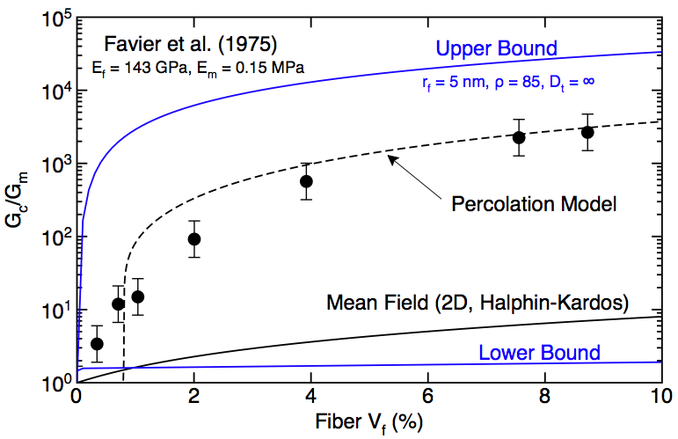
Alternate View: Use Better Mean Field
Favier et al. (1995)
Experiments greatly exceed
“expectation” from mean-field
modeling
X
Mean Field (2D, Halpin-Kardos)
Slide courtesy of Prof. John Nairn, OSU

Slide 25
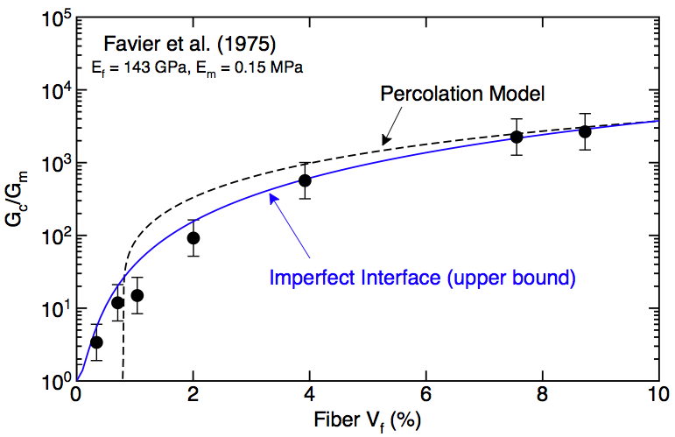
Alternate View: Interface vs. Percolation
Experiments explained by
“percolation” which is a
nano phenomenon
X
Favier et al. (1995)
“Modulus Percolation” - Ec increases slowly at first and then faster
Consequence of micromechanics and not of connectivity
Slide courtesy of Prof. John Nairn, OSU

Slide 26
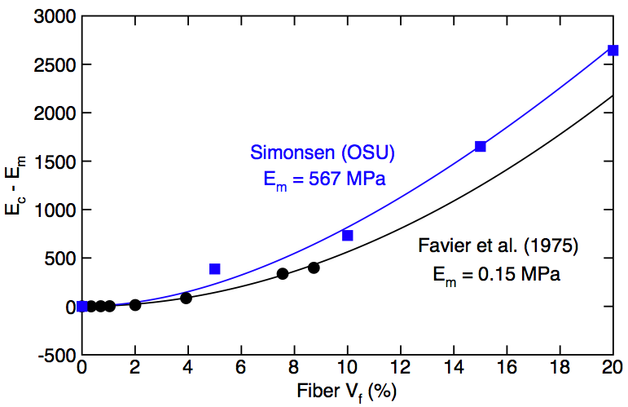
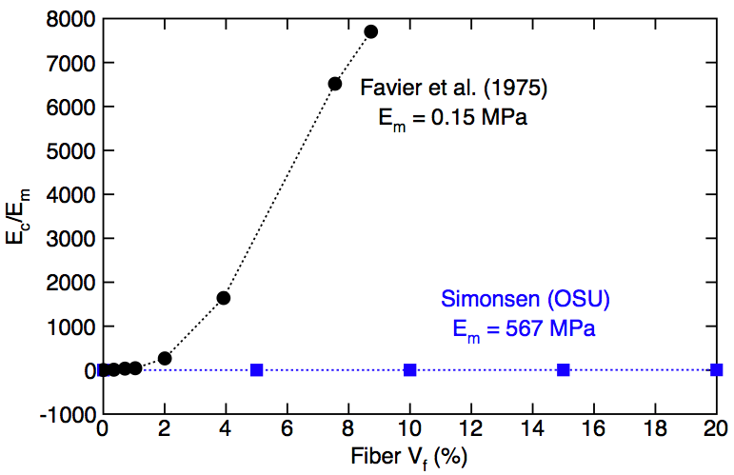
Alternate View: Ec/Em is Misleading
Great reinforcement
of the matrix
(>1000X)
X
Favier et al. (1995)
Favier et al. (1995)
Fiber reinforcement effects should be characterized by Ec - Em and not Ec/Em
Slide courtesy of Prof. John Nairn, OSU

Slide 27
More comparisons

Slide 28
Is it percolation or is it a bad interphase?
Or both?.....

Slide 29
Hypothesis: If the CNCs are crosslinked in a way that does not respond to water, then exposure to water should not reduce the modulus
If only percolation changes, then no change in modulus
If only interphase changes, modulus will change about the same as uncrosslinked composite
If matrix also changes, properties will change, but less than unfilled control

Slide 30
Ionic crosslinking
Form a CNC gel, “aquagel,” in water
Dry using supercritical CO₂
Infuse the aerogel with polymer solution
  3D spatial distribution
Evaporate solvent
Test composite wet and dry

Slide 31

Cellulose nanocrystals
Bio Vision technology, inc.
Nanocel™
One step process
Can use a variety of biomass raw materials
(NH₄)₂S₂O₈
pH 1
~0.5 mmol/g CO₂H
Biomass
CNCs + waste
C.CNCs
60 – 80 °C
16 h
diafiltration
WO 2011072365, Mar 15, 2010

Slide 32
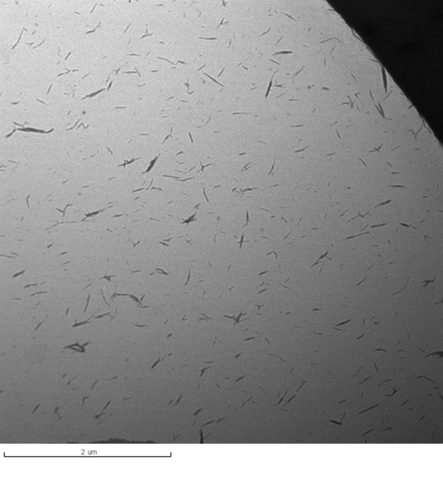
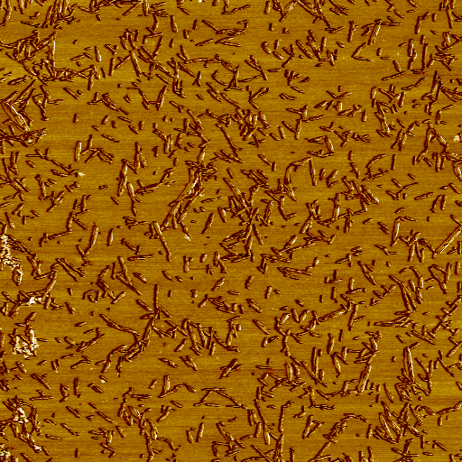
Bio Vision technology, inc.
Nanocel™
2 μm
0
5μm
0
5 μm
Slide courtesy of Bio Vision Tech. Inc.

Slide 33
Ionic crosslinking:
Aquagel formation
CO₂
CO₂
CO₂
CO₂
CO₂
CO₂
CO₂
CO₂
M³⁺
M³⁺
M³⁺
CO₂
CO₂
M³⁺
CO₂
CO₂
CO₂
CO₂
CO₂
M = Al³⁺, Fe³⁺, Zr⁴⁺, Dy³⁺

Slide 34
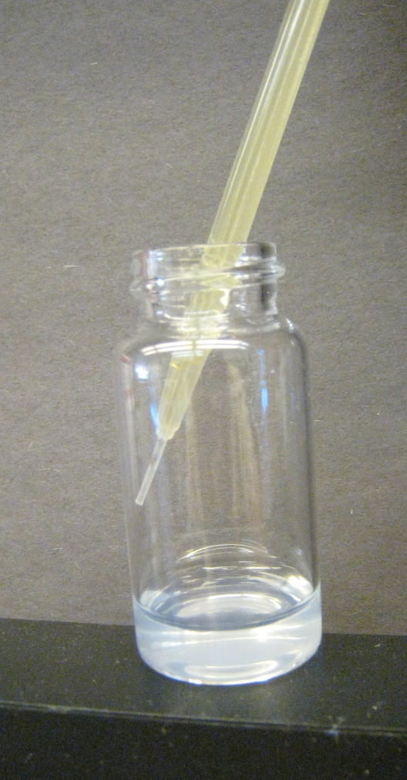
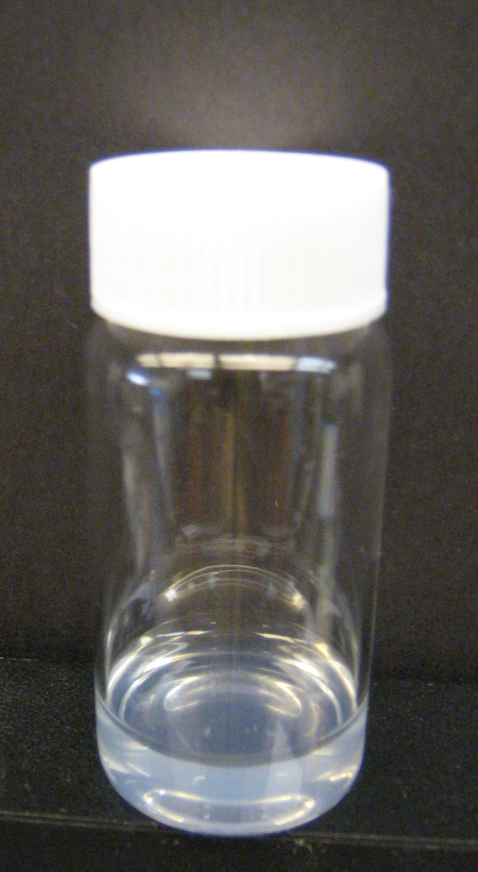
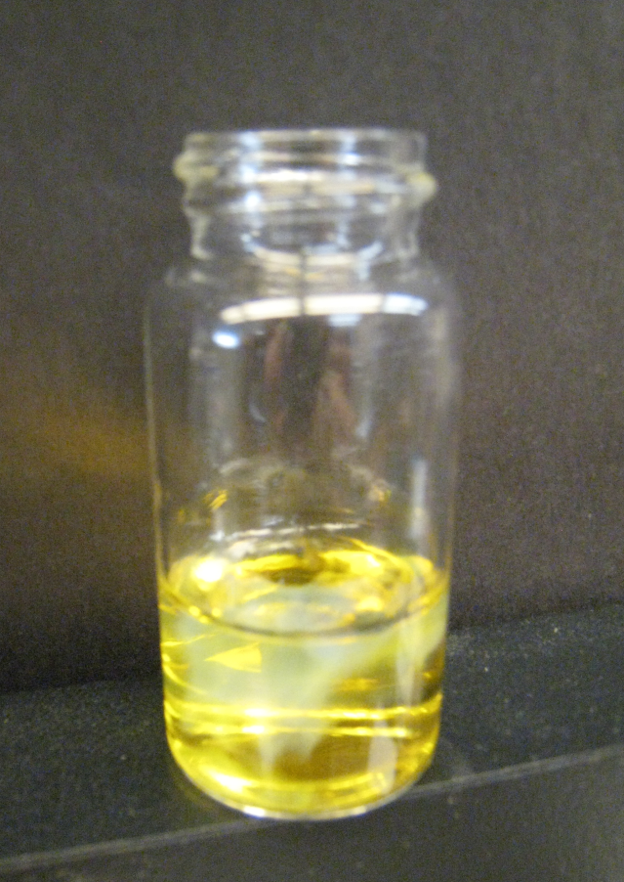
Rapid Gelation
CNC solution
Add Fe(NO₃)₃
Aquagel

Slide 35
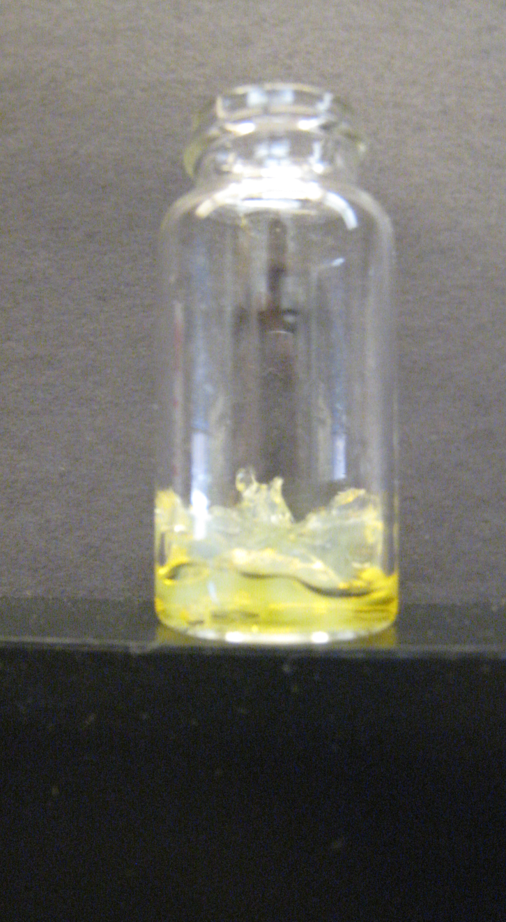
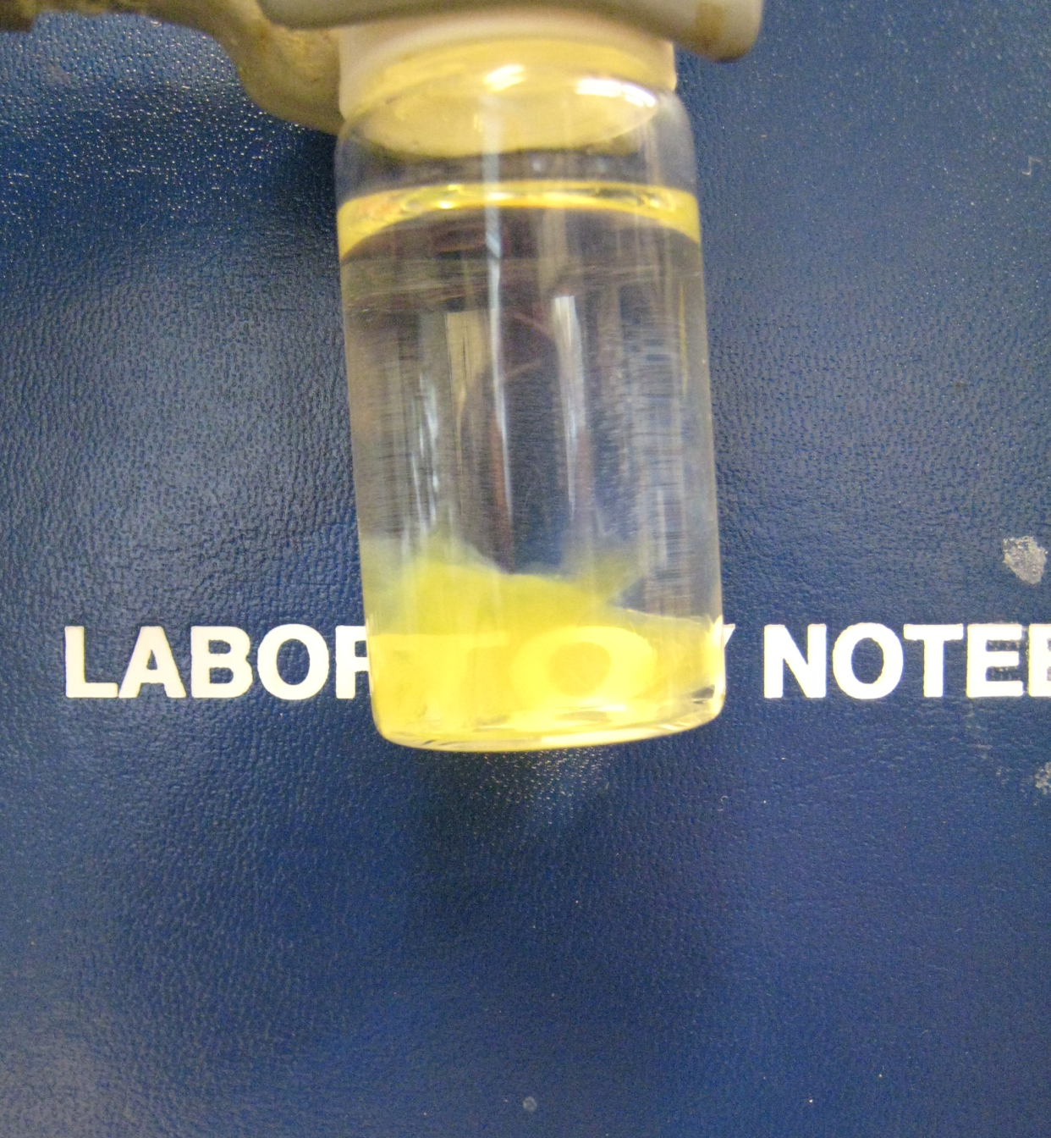
decant
A low density aquagel

Slide 36
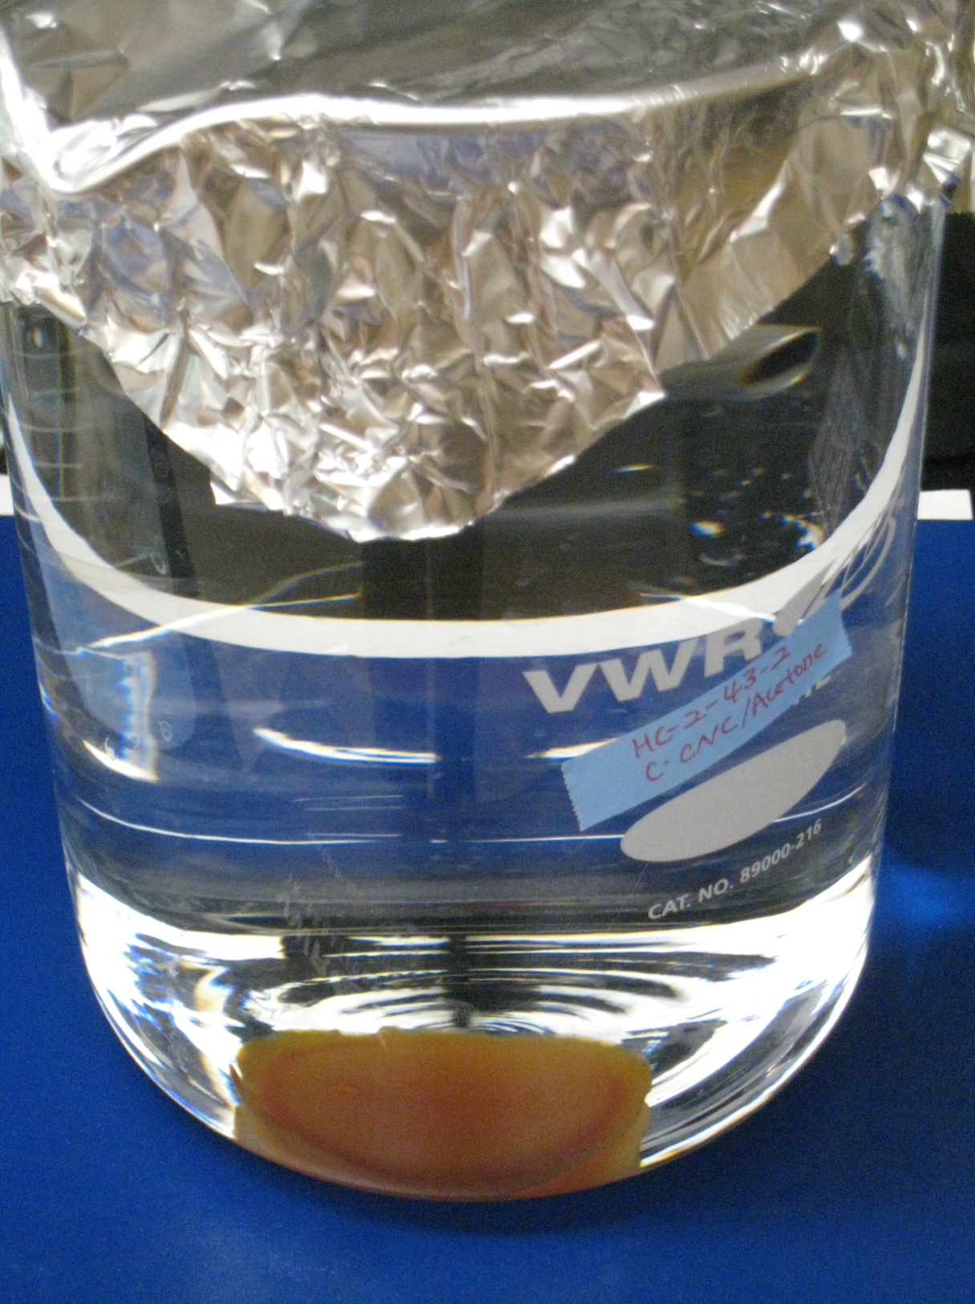
Iron crosslinked CNC aquagel

Slide 37
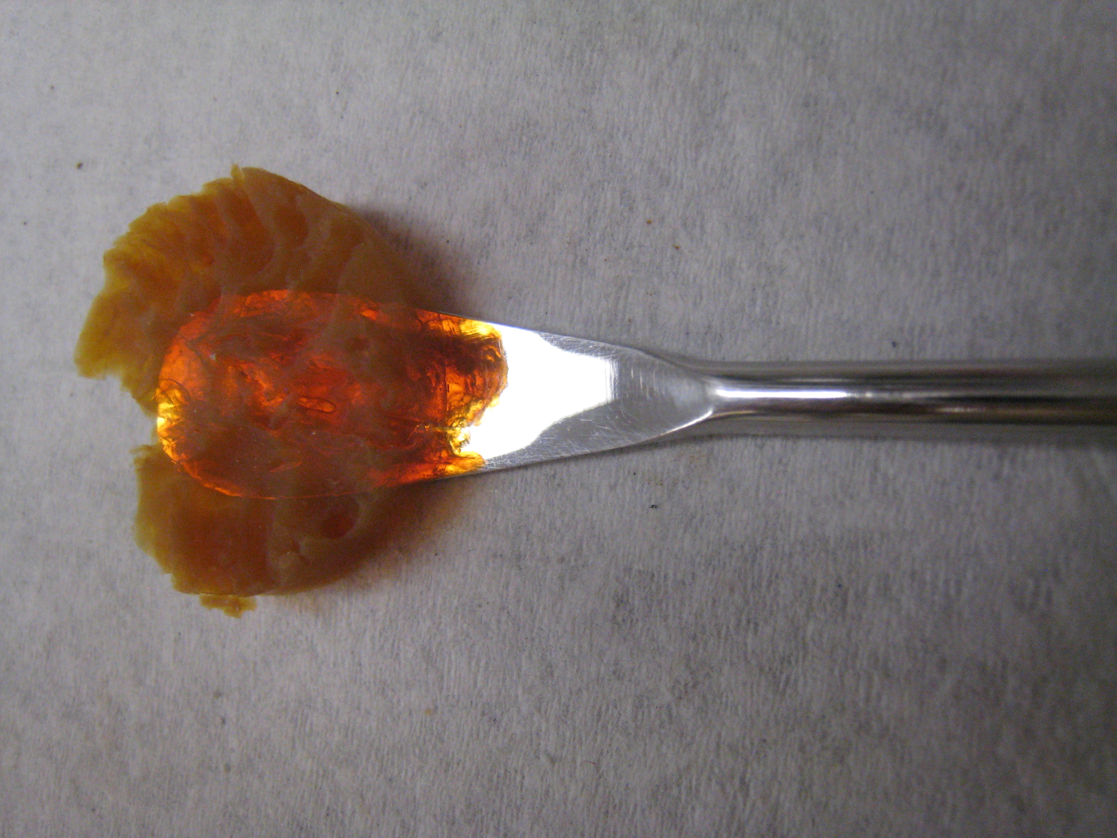
Iron crosslinked CNC aerogel

Slide 38
10 nm

Slide 40
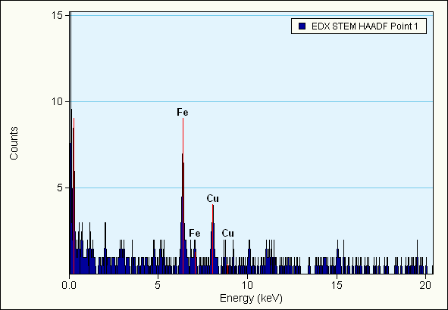
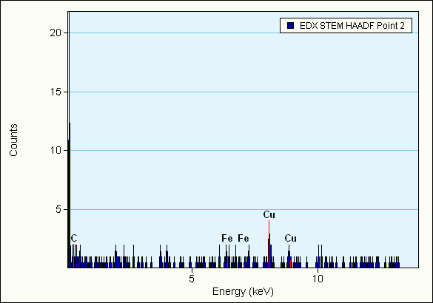
Fe present
No Fe

Slide 41
Sample prep
Form aquagel
Transfer solvent to acetone
Transfer to PVAc solution (10%)
Dry carefully
Test via compression for bulk modulus

Slide 42
Preliminary data suggests interphase is more important!

Slide 43
Questions?

